Slide 1
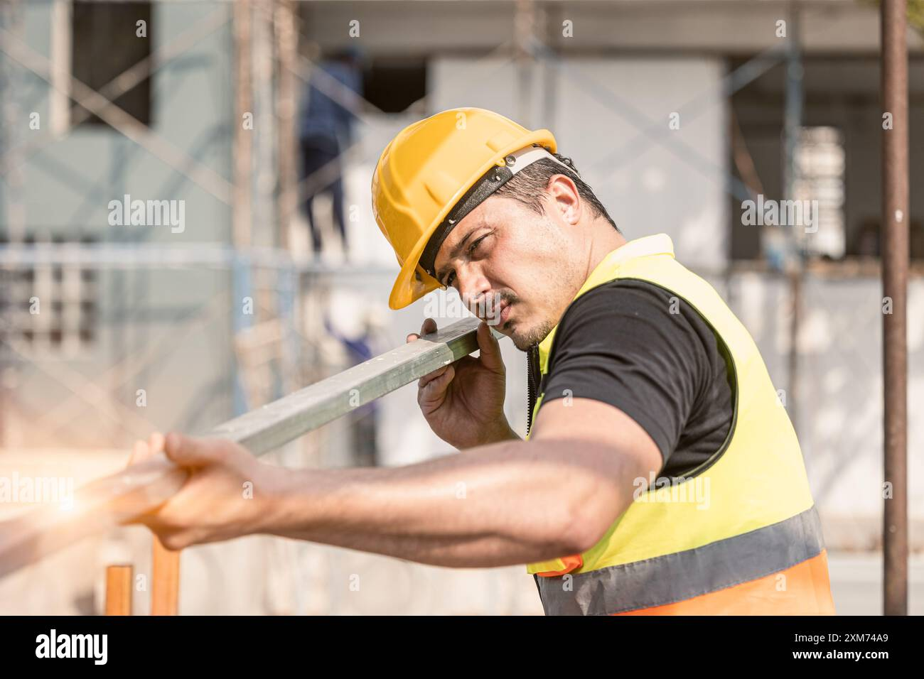
Construction Safety Monitoring
AI-Powered PPE Compliance Detection
Deep Learning for Workplace Safety
Automated detection of safety helmets and reflective vests using YOLO models to protect construction workers.
Mohamed Ibrahim 236671 | Shahd Ahmed 233341

Slide 2
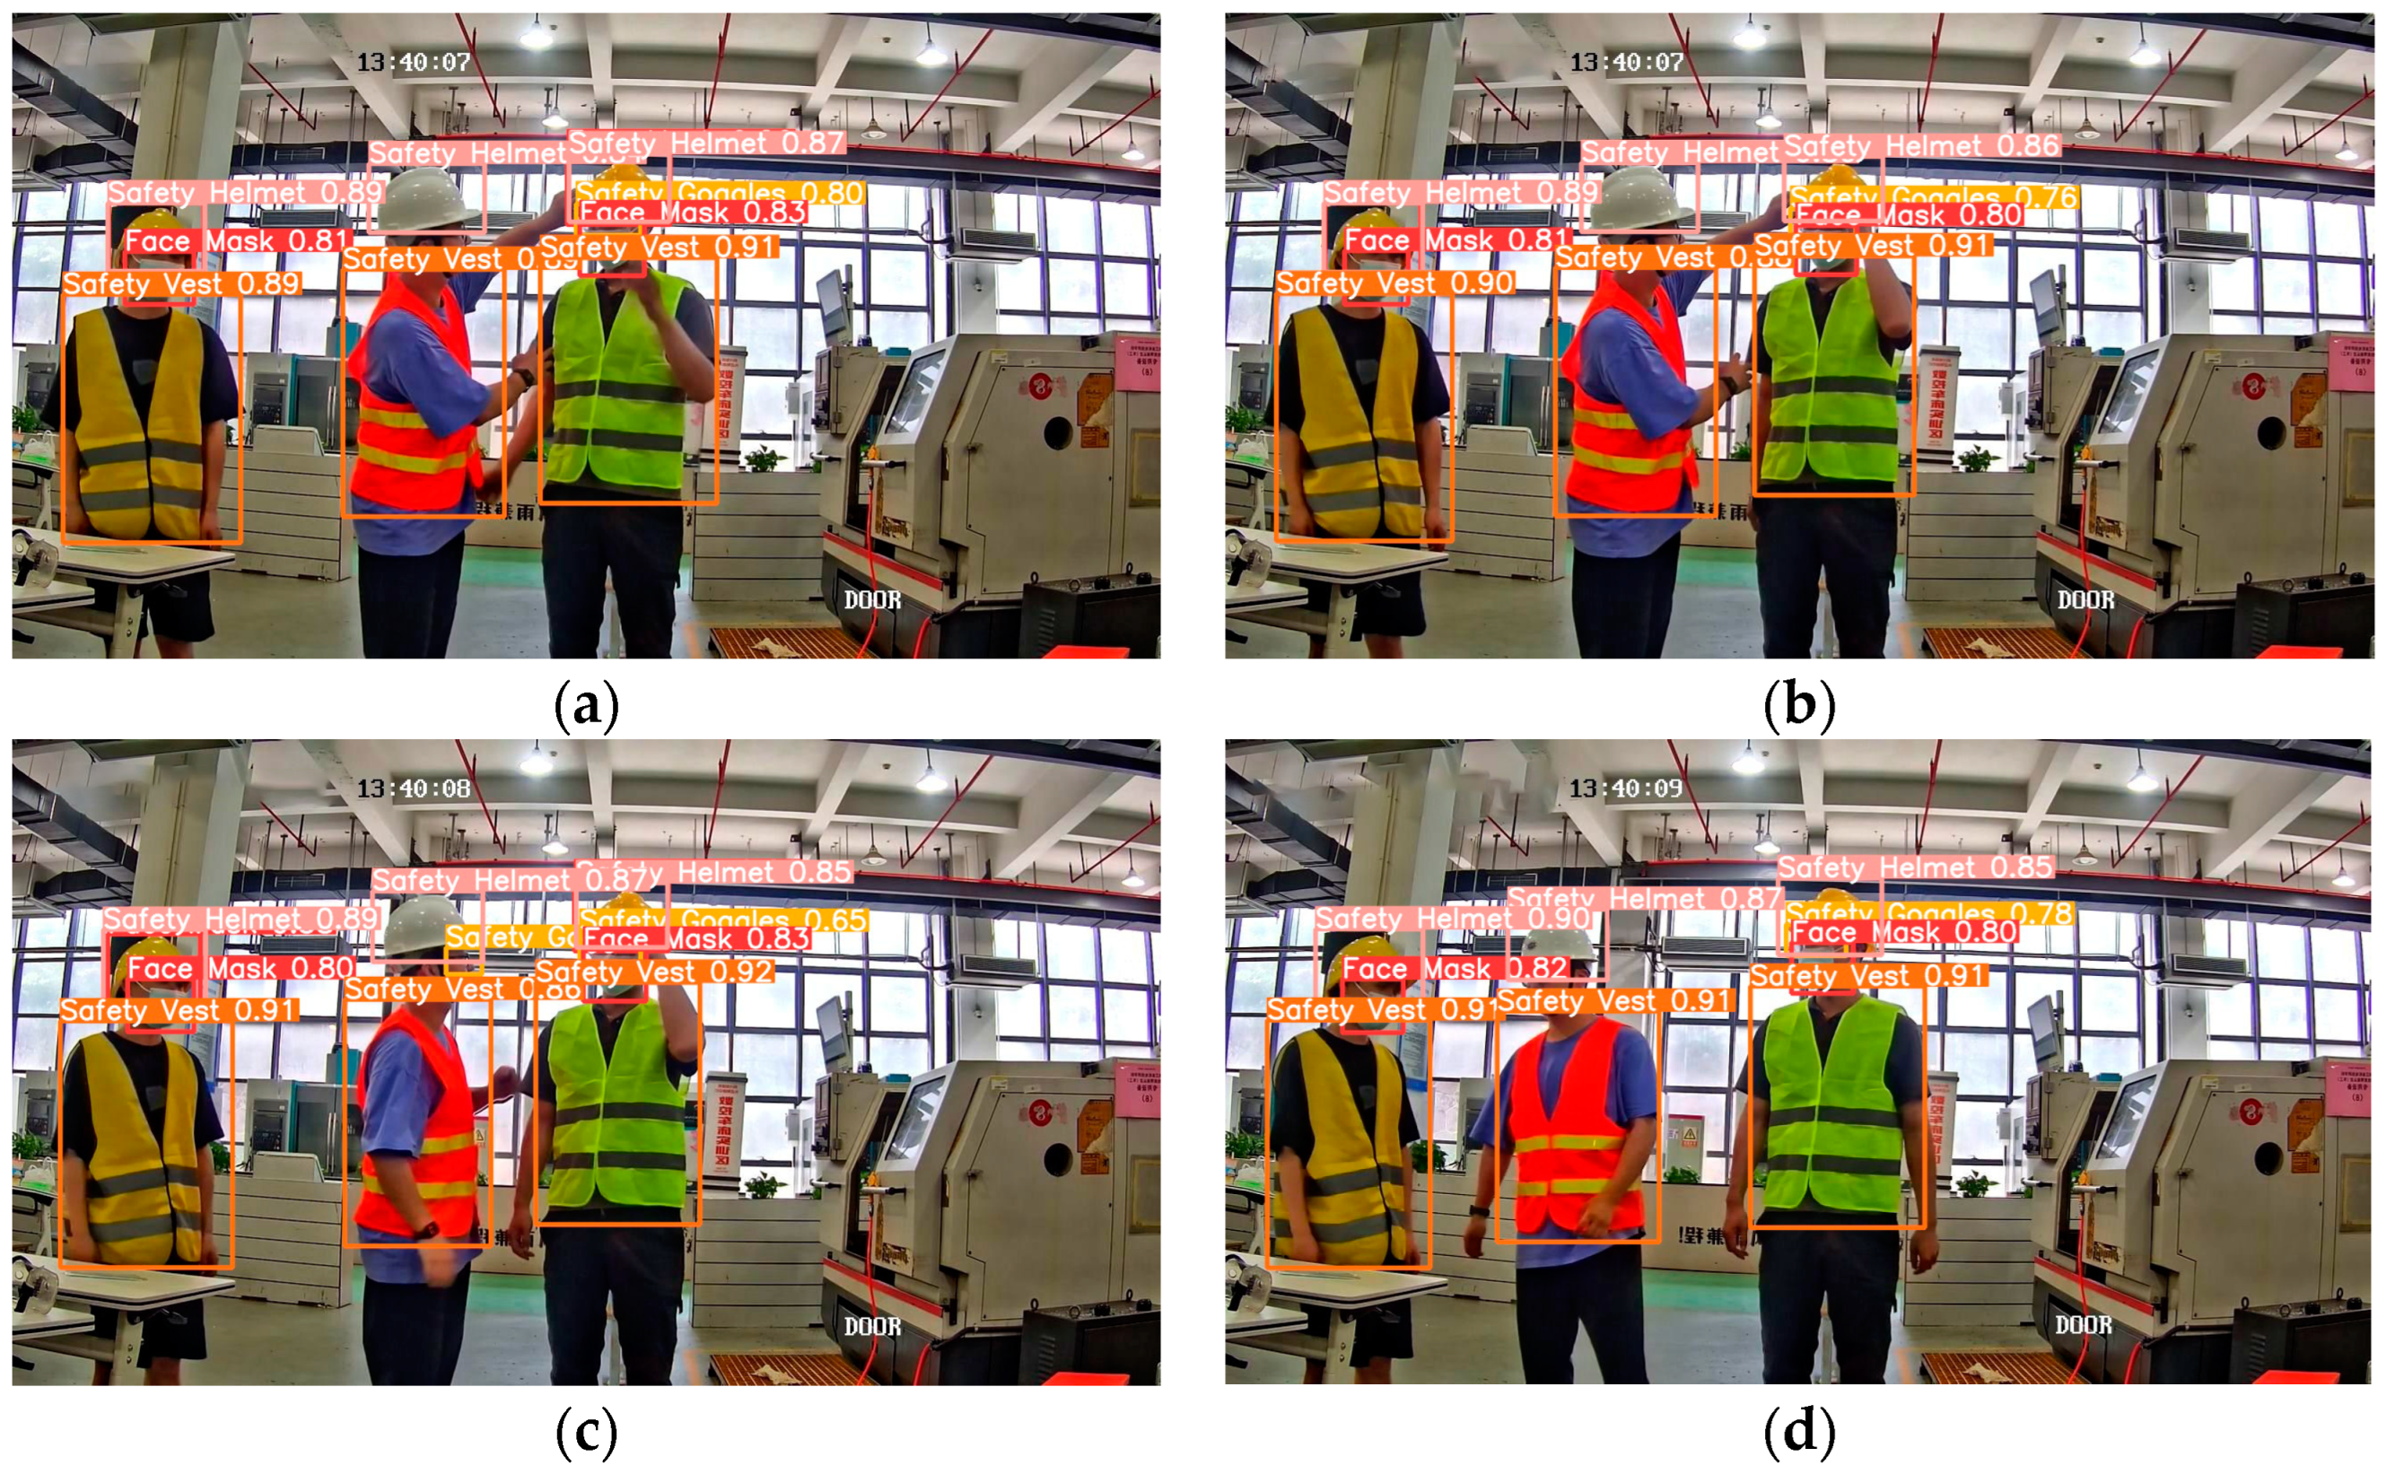
AGENDA
Comprehensive overview of construction safety monitoring system development and implementation.
Introduction & Problem
Background & Literature
01
02
Dataset Overview
YOLO Model Comparison
03
04
System Architecture
Implementation & Results
05
06
Discussion & Conclusion
07

Slide 3

Introduction
The Problem Safety Monitoring Challenges
Multiple Workers - Simultaneous activities across large sites
PPE Non-compliance - Workers ignore or remove safety gear
Manual Monitoring Impossible - 24/7 surveillance unrealistic
Multiple Cameras - Supervisors can't watch all feeds
•
Accident Risk - Helmets and vests critical for protection

Slide 4
INTRODUCTION
Objectives & Project Scope
Main Objectives
01
Detect Workers
Identify all workers in construction images and video frames
Project Scope
02
Check PPE Compliance
Verify 11 PPE classes using dataset labels
Primary PPE: Safety helmets and reflective vests
03
Visual Highlighting
Methodology: YOLO-based deep learning detection
Mark compliant vs. non-compliant workers clearly
Capability: Real-time image and video processing
04
Statistics Dashboard
Display total workers, compliance counts, violations
Output: Annotated frames + statistical summaries

Slide 5
Project Overview
Introduction & Problem Statement
Construction sites face significant safety challenges with manual PPE monitoring being impossible 24/7. Supervisors cannot watch every worker and camera constantly, creating dangerous compliance gaps.
Project Objectives
Detect workers in construction images/videos
Verify PPE compliance (helmet, vest, gloves, goggles)
Display statistics: total workers, compliant vs non-compliant

Slide 6
Background & Literature Review
Part 1: 2020-2021 Research
Foundational work in automated construction safety monitoring
Fang et al.
2021
Automation in Construction, Vol. 124
Real-time Detection of Construction Workers' Helmet Wearing
Key Insights & Impact
Methodology
CNN-based approach with real-time video processing on construction sites
1
Proved deep learning effectively solves PPE monitoring
High accuracy achieved in helmet detection scenarios
Practical viability demonstrated for site deployment
2
Real-time detection is feasible with optimized CNN models
Automated monitoring reduces manual oversight needs
Directly relevant to our helmet detection focus
3
Set foundation for multi-PPE detection approaches

Slide 7
Background & Literature Review
Part 2: 2022-2023 Research & Dataset
2022
Zhou & Chen
Dataset Information
YOLO-based PPE monitoring — Fine-tuned YOLOv5 on construction images with good mAP scores and real-time performance
Sanyal (2022) — Construction Site Safety Image Dataset (Kaggle/Roboflow)
2021
Wang et al.
YOLO version comparison — Found YOLOv5s provides optimal speed-accuracy balance for PPE detection
YOLO format — Pre-labeled images + .txt annotation files ready for training
Real scenes — Construction site environments with workers and safety equipment
2023
Lee et al.
YOLOv7 performance — Concluded YOLOv7 performs best for helmets and vests detection
Convenience — Compatible format makes training and testing straightforward
These studies informed our YOLO model selection strategy and established best practices for construction safety monitoring

Slide 8
Related Work
Background & Literature Review
Key research contributions in construction safety monitoring using deep learning and computer vision.
2021
2020
2022
Fang et al.
Kim & Lee
Zhou & Chen
Real-time helmet wearing detection using deep learning
Computer vision system for monitoring safety equipment
PPE compliance monitoring using YOLO-based models
High accuracy helmet monitoring with CNN-based approach
Faster R-CNN for helmets and harnesses with automated alerts
Fine-tuned YOLOv5 with good mAP and real-time performance
2021
2023
Dataset Used
Construction Site Safety Image Dataset (Kaggle/Roboflow) - Sanyal, 2022
Wang et al.
Lee et al.
Fast PPE detection for construction sites
Real-time PPE compliance detection
YOLOv5s gives best speed-accuracy balance
YOLOv7 performs best for helmets and vests

Slide 9
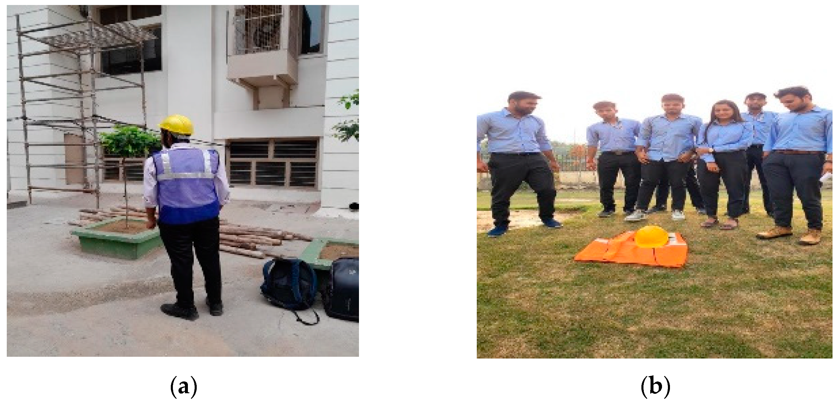
Methodology
Dataset Details
Compliance Classes
Non-Compliance Classes
Helmet
✓
Gloves
✓
none
✗
no_helmet
✗
Vest
✓
Boots
✓
no_goggle
✗
no_gloves
✗
Goggles
✓
Person
✓
no_boots
✗
YOLO Format: Images + .txt annotations ready for training
Construction Site Safety Image Dataset
Source: Kaggle (Sanyal, 2022) • YOLO Format
Real construction scenes with labeled PPE detection

Slide 10
Methodology
Dataset Overview
Source: Kaggle (Roboflow) by Sanyal (2022)
11 PPE Classes
Helmet ✓
Gloves ✓
Vest ✓
Boots ✓
Goggles ✓
Person
no_helmet ✗
no_goggle ✗
no_gloves ✗
no_boots ✗
none
Real construction scenes with labeled PPE
YOLO Format
Data Split
Labels + .txt files
Train / Val / Test

Slide 11
Methodology
YOLO Model Selection Process
Training Process
v8
YOLO v8n
v8
YOLO v8x
Configured YAML with dataset paths and class names
Nano variant • Lightweight & fast
Extra large • High accuracy
Set hyperparameters: epochs, batch size, image size
Monitored metrics: loss, precision, recall, mAP
v11
YOLO v11n
v11
YOLO v11x
New nano • Optimized architecture
New extra large • Best overall
Selection Criteria
Accuracy
Speed
Efficiency
SELECTED

Slide 12
System Design
System Architecture
01
Input Source
Image or video frame upload
02
YOLO v11x Engine
Object detection: workers, helmets, vests
03
PPE Compliance
Check compliance, classify workers
04
Output Display
Annotated image + statistics dashboard

Slide 13
System Design
Sequence Diagram & Workflow
1
Upload Image/Video
User uploads construction site image to GUI
2
Send to Detection Engine
System forwards image to YOLO v11x model
Compliance Logic
3
Object Detection
Detect workers, helmets, vests with bounding boxes
Worker is COMPLIANT if: ✓ Person detected ✓ Helmet detected ✓ Vest detected
4
PPE Compliance Check
Verify worker has helmet + vest
5
Generate Annotated Output
Compliant
Non-Compliant
Color-coded boxes: green=compliant, red=violation
6
Display Statistics
Show total workers, compliant count, violations

Slide 14
System Design
System Architecture
01
Input Source
03
PPE Compliance
•
Image or video frame upload
Check compliance, classify workers
02
YOLO v11x Engine
04
Output Display
Object detection: workers, helmets, vests
Annotated image + statistics dashboard

Slide 15
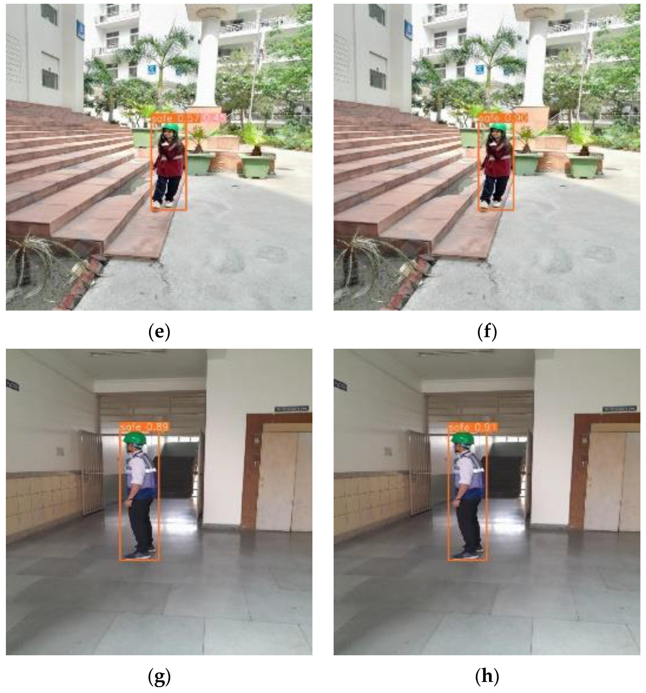
System Features
Implementation & Key Features
Upload & Detect
Simple interface for images/videos
Auto PPE Recognition
YOLO v11x model with colored boxes
Clear Visual Results
Labels, confidence scores, violation flags
Quick Statistics
Safe vs. Unsafe Detection Results
Total workers, compliant, violations

Slide 16
Results & Analysis
Per-Class Performance Analysis
•
Helmet
Excellent
•
Vest
Perfect
Boots
Perfect
Precision
Recall
F1
Precision
Recall
F1
Precision
Recall
F1
0.99
1.00
0.99
1.00
1.00
1.00
1.00
1.00
1.00
Support
89
Support
72
Support
69
Person
Perfect
Goggles
Perfect
no_helmet
Good
Precision
Recall
F1
Precision
Recall
F1
Precision
Recall
F1
1.00
1.00
1.00
1.00
1.00
1.00
0.93
1.00
0.96
Support
128
Support
16
Support
13
Perfect Classes
Excellent Classes
Total Samples
4
1
433

Slide 17
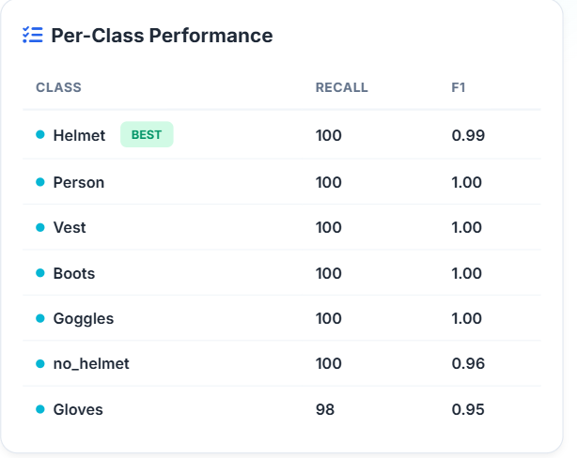
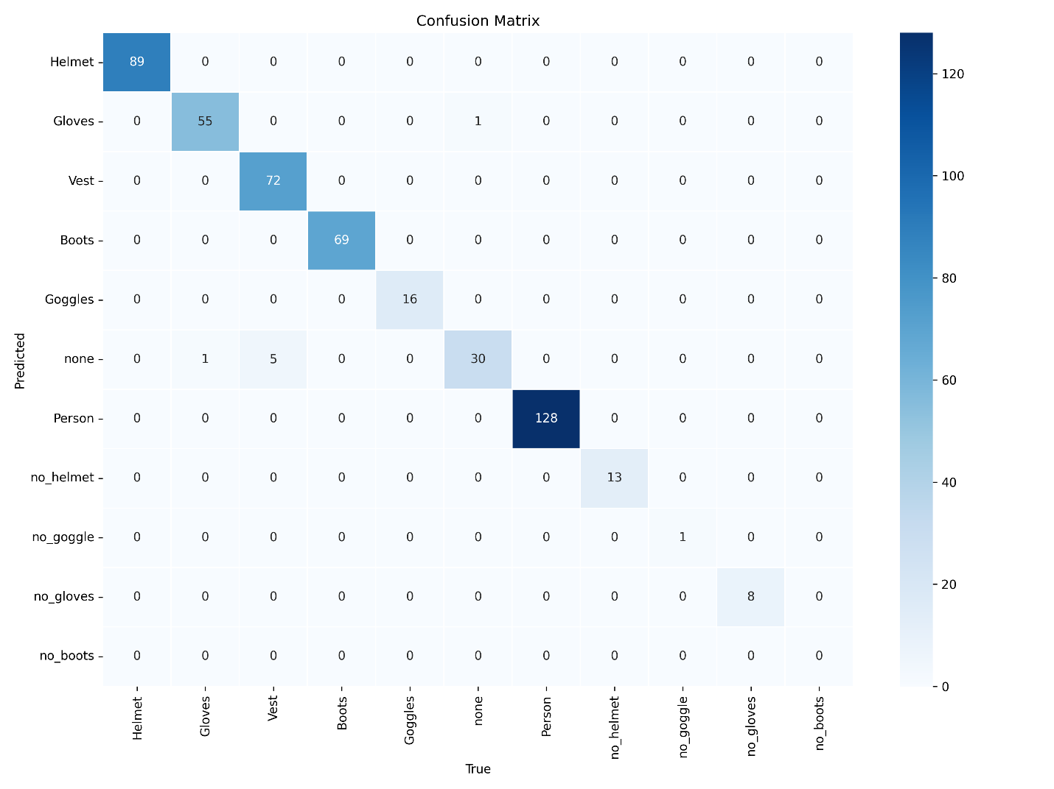
MODEL PERFORMANCE
Results & Performance Metrics
98.57%
0.98
0.98
Per-Class Performance
Accuracy
Precision
F1-Score
•

Slide 18
EVALUATION & LEARNINGS
Discussion
What Worked Well
Challenges & Solutions
Annotated Dataset
Slow Training Speed
Pre-labeled YOLO-compatible dataset saved significant time
🕒
Big models took too long on hardware
Ultralytics API
Solution: Reduced image size & batch, tested lighter models first
Simple and efficient for training/testing different YOLO variants
Visual Outputs
Bounding boxes and labels made system easy to understand
Model Generalization
Real-time Performance
Varying lighting and camera angles affected accuracy
Good balance of speed and accuracy for practical use
Solution: Need more diverse training data
Far Worker Detection
Small/far workers were harder to detect
Solution: Higher inference resolution, tuned confidence thresholds

Slide 19
Conclusion & Future Work
What We Achieved
Future Improvements
Developed automated safety monitoring system using YOLO v11x
Achieved 98.57% accuracy on test set
Add more PPE types (harnesses, ear protection, masks)
Improve detection accuracy for distant/partial workers
Include night/low-light images for 24/7 coverage
Built Streamlit GUI for real-time PPE detection
Enhance model generalization across diverse conditions
Trained model on real construction PPE dataset with 11 classes

Slide 20
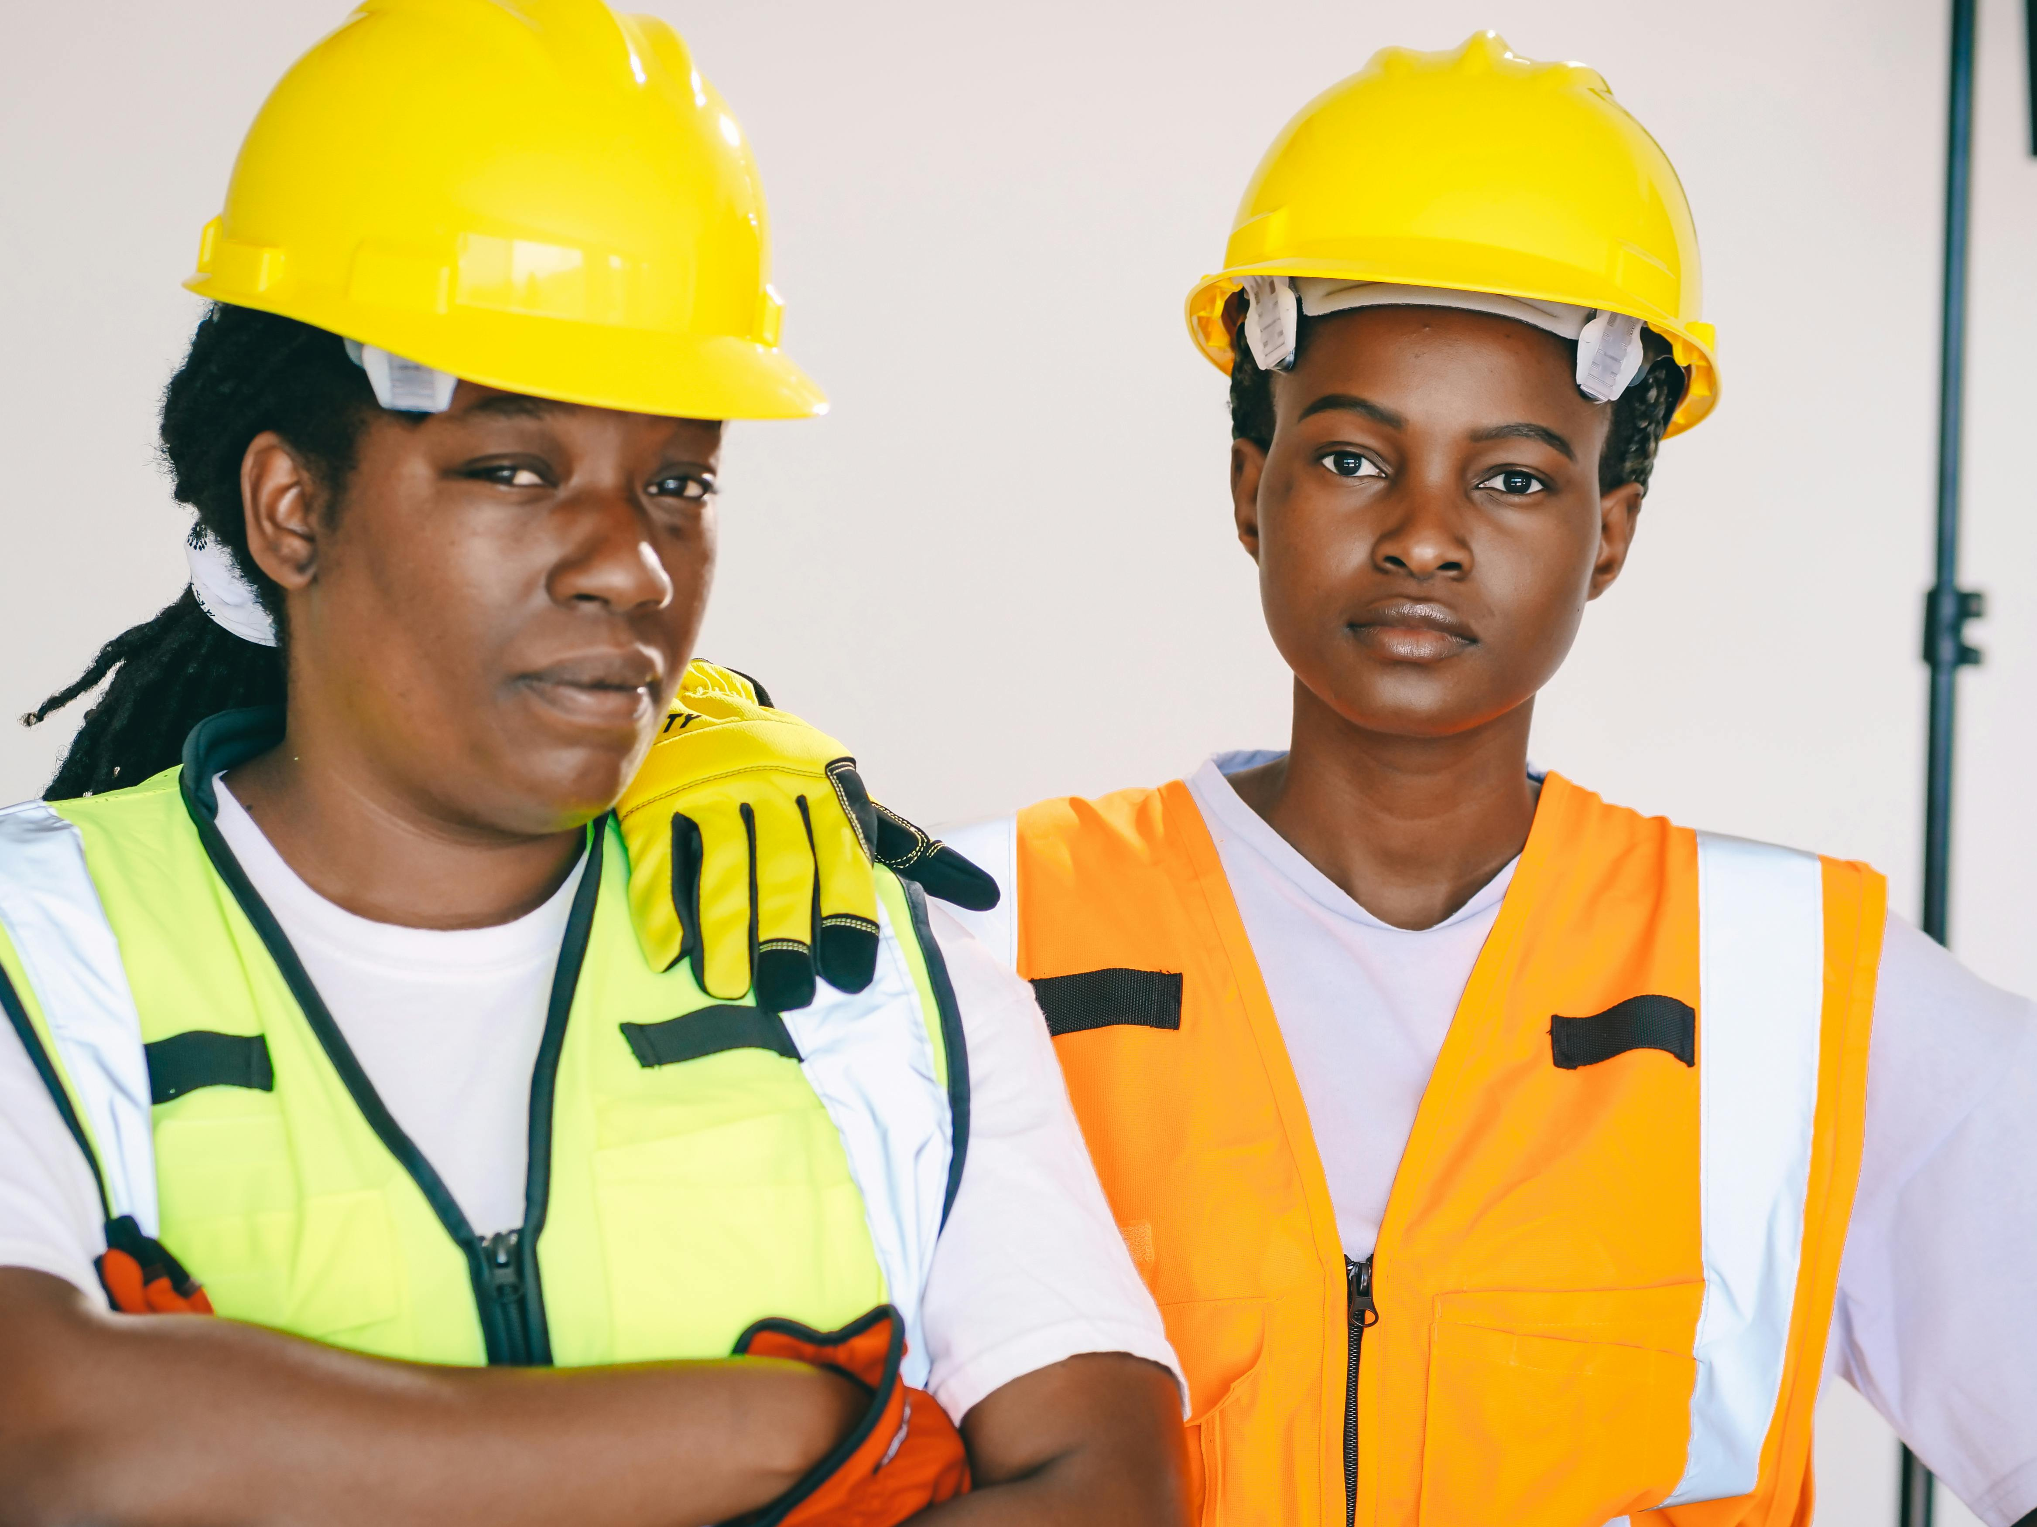
Thank You

